Slide 1
Basic Grammer

Slide 2
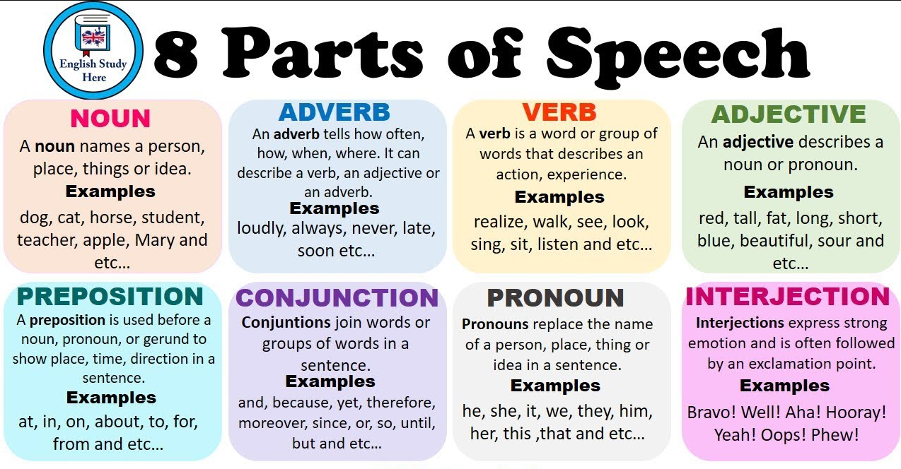

Slide 3
Past Tense

Slide 4
SUBJECT | SINGULAR | PLURAL
1st Person | I write | We write
2nd Person | You write | You write
3rd Person | He/She/It writes | They write

Slide 5
TENSES | APPLICATION | EXAMPLE
Past Simple | Action or event that happened in the past | She met me at the cafeteria
Past Perfect | An action or event happened in the past before another event that happened in the past | He had eaten his lunch before we reached the venue
Past Continuous | Action or event that was continuing in the past | It was raining last week
Past Perfect Continuous | Action or event that was taking place in the past until another action or event happened in the past | He had been practicing the guitar when the teacher called for him

Slide 6
TENSES | RULES
Past Simple | Subject + Verb/Verb+ed
Past Perfect | Subject + had + Verb+ed
Past Continuous | Subject + was/were + Verb+ing
Past Perfect Continuous | Subject + had been + Verb+ing

Slide 7
TENSES | AFFIRMATIVE | NEGATIVE | INTERROGATIVE
Past Simple | I lived in London | I didn’t live in London | Did I live in London?
Past Perfect | He had worked | He had not worked | Had he worked?
Past Continuous | I was playing | I wasn’t playing | Was I playing?
Past Perfect Continuous | I had been watching | I had not been watching | Had I been watching?

Slide 8
Present Tense

Slide 9
SUBJECT | SINGULAR | PLURAL
1st Person | I write | We write
2nd Person | You write | You write
3rd Person | He/She/It writes | They write

Slide 10
TENSES | APPLICATION | EXAMPLE
Present Simple | Current action or an action that takes place regularly | I go to office everyday
Present Perfect | Action that started in the past and continues in the present | I have lived in London since 2001
Present Continuous | Action that is continuing at the present moment | He is watching a movie
Present Perfect Continuous | Action that began in the recent past and is still continuing | I have been waiting for them for a long time

Slide 11
TENSES | RULES
 | SINGULAR | PLURAL
Present Simple | Subject + Verb/Verb+s (3rd person singular) | Subject + Verb
Present Perfect | Subject + has or have+ Verb | Subject + have + Verb
Present Continuous | Subject + is/am/are + Verb+ing
Present Perfect Continuous | Subject + has or have been + Verb+ing | Subject + have been + Verb+ing

Slide 12
TENSES | AFFIRMATIVE | NEGATIVE | INTERROGATIVE
Present Simple | I have a car | I don’t have a car | Do I have a car?
Present Perfect | I have seen that movie | I haven’t seen that movie | Have I seen that movie?
Present Continuous | You are playing football now | You are not playing football now | Are you playing football now?
Present Perfect Continuous | They have been living here | They haven’t been living here | Have they been living here?

Slide 13
Future Tense

Slide 14
SUBJECT | SINGULAR | PLURAL
1st Person | I write | We write
2nd Person | You write | You write
3rd Person | He/She/It writes | They write

Slide 15
TENSES | APPLICATION | EXAMPLE
Future Simple | Action or event that will happen in the future | I will play tennis tomorrow evening
Future Perfect | Action that will have been completed at some point in the future | By September, Jenny will have taken over that role
Future Continuous | Action that will be ongoing in the future | Katherine will be coming home for holidays
Future Perfect Continuous | Action that is currently unfinished but will be finished at some future time | I will have been waiting here for 3 hours by six o’clock

Slide 16
TENSES | RULES
Future Simple | Subject + will/shall + Verb
Future Perfect | Subject + will/shall + have + Verb
Future Continuous | Subject + will/shall + be + Verb+ing
Future Perfect Continuous | Subject + will + have been + Verb+ing

Slide 17
TENSES | AFFIRMATIVE | NEGATIVE | INTERROGATIVE
Future Simple | I will come | I will not come | Will I come?
Future Perfect | He will have finished | He will not have finished | Will he have finished?
Future Continuous | I will be playing basketball | I won’t be playing basketball | Will I be playing basketball?
Future Perfect Continuous | We will have been starting | We will not have been starting | Will we have been starting?

Slide 18
Subject Verb Agreement

Slide 19
Rules
A singular subject takes a singular verb whereas a plural subject takes a plural verb.
Eg: One dog is sitting on the grass.
Two dogs are sitting on the grass.
Two singular subjects connected by or, either/or, or neither/nor and sometimes the subject is separated from the verb by such words as along with, as well as, besides etc. takes a singular verb.
Eg: My aunt or my uncle is arriving by train today. Neither Juan nor Carmen is available. Either Kiana or Casey is helping today with stage decorations.
The politician, along with the newsmen, is expected shortly. Excitement, as well as nervousness, is the cause of her shaking.

Slide 20
Rules
Use a singular verb with distances, periods of time, sums of money, etc., when considered as a unit.
Eg: Three miles is too far to walk. Five years is the maximum sentence for that offense. Ten dollars is a high price to pay.
Use a plural verb with two or more subjects when they are connected by and.
Eg: A car and a bike are my means of transportation.
With collective nouns such as group, jury, family, audience, population, the verb might be singular or plural, depending on the writer's intent.
Eg: All of my family has arrived OR have arrived. Most of the jury is here OR are here. A third of the population was not in favor OR were not in favor of the bill.

